Slide 1
Linear Regression in Machine Learning
An Introduction to Predictive Modeling

Slide 2
Introduction
Linear Regression is a supervised learning algorithm used to model the relationship between a dependent variable and one or more independent variables.

Slide 3
Types of Linear Regression
1. Simple Linear Regression: Uses one independent variable.
2. Multiple Linear Regression: Uses multiple independent variables.

Slide 4
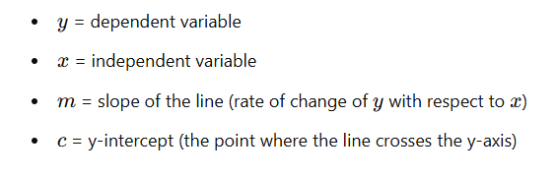
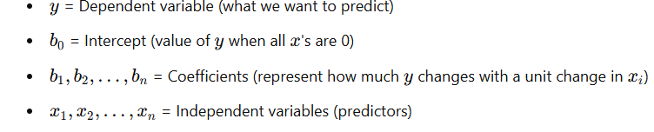
Mathematical Equations
Simple Linear Regression: y = mx + c
Multiple Linear Regression: y = b0 + b1x1 + b2x2 + ... + bnxn

Slide 5
Python Implementation (scikit-learn)
1. Import libraries
2. Load dataset
3. Train-Test Split
4. Train model using LinearRegression()
5. Make Predictions
6. Evaluate using MSE

Slide 6
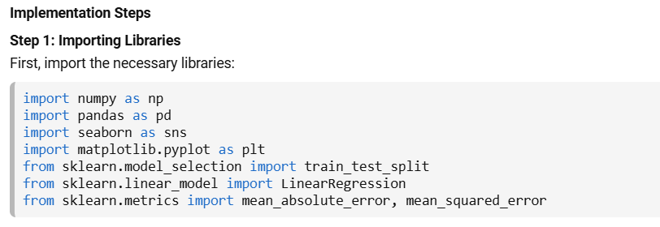
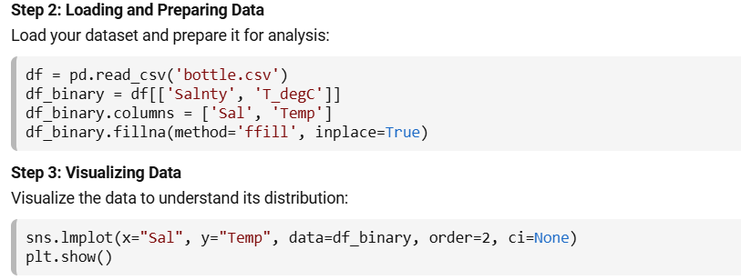

Slide 7
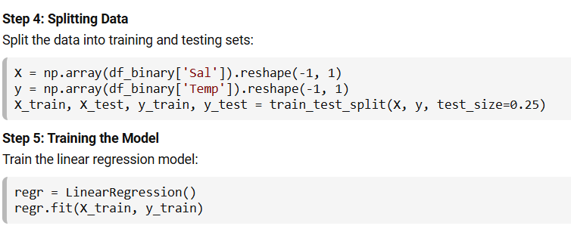
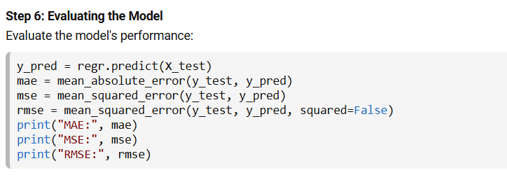

Slide 8
Applications of Linear Regression
- House Price Prediction
- Sales Forecasting
- Stock Market Analysis
- Business Analytics
- Medical Data Analysis

